Slide 1
Project 3
Nuclear
Jack Lovrinic

Slide 2
ideas?
I started off with trying to do a 3D snake game, but there were issues wich the segments of the snake that would not stick well to the other segments, this ruined the overall feeling of it, I tried using Joints, and other techniques, but due to time constraints I had to pivot.

Slide 3
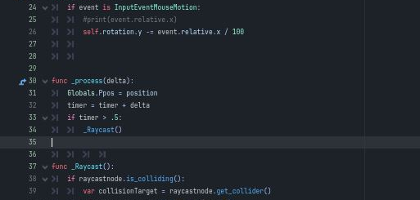
The Player movement was relatively simple, it just relied on W key and Mouse input for left right rotation. I used ray casts for interaction as a result of trying to be more choosy with how the player interacts. I was thinking of this way being closer than a collision test. It’s more narrowed down

Slide 4
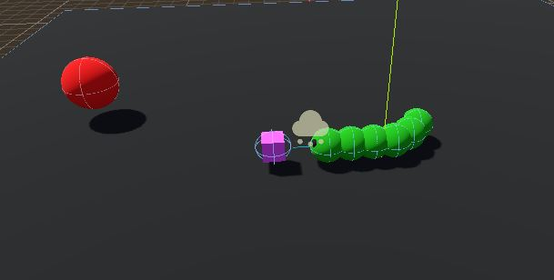
Unfortunately during gameplay the segments would break

Slide 5
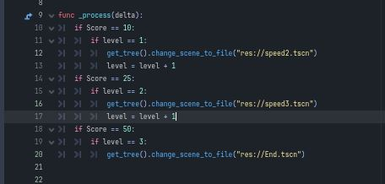
I used Autoload to make global variables that could be accessed anywhere, this was handy for putting the score on the screen and having it update correctly. I was also able to handle the level transitions from here.

Slide 6
Solution
The Snake segments started piling up and shaking and to me it looked like mass colliding into some sort of black hole. I thought it would be cool to do a game around that.
Now when the player reaches the purple mass, the mass in the center of the map grows.
The further you get into the game the more enemies come after you. This is dark matter coming to stop you.

Slide 7
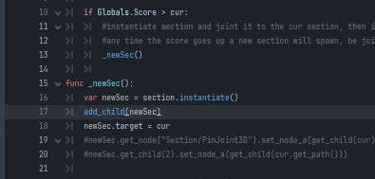
This is where I originally tried to handle making the snake, but the methods I used didn’t work well enough and a lot of it was jumpy, so I just dug in with it and decided to make it look like unstable matter. I had to comment out a lot.

Slide 8
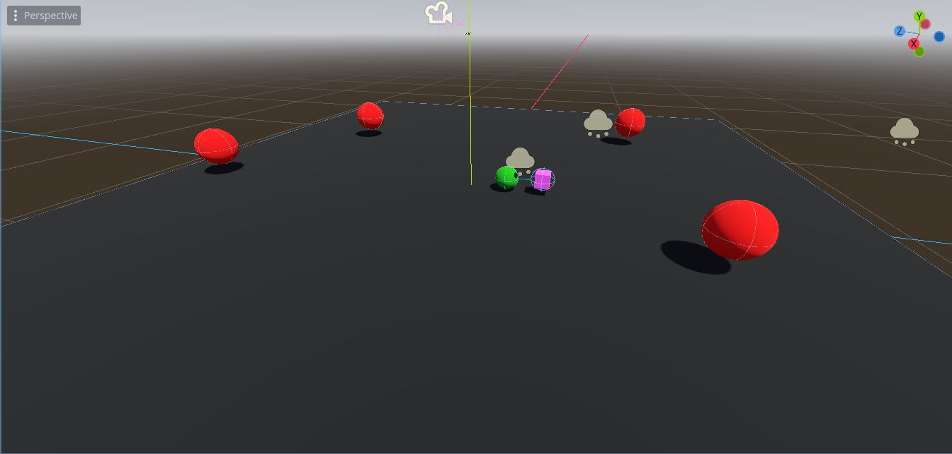
Despite there not being much on the map, the fast paced and quickly changing nature of the map makes it just as interesting to play.

Slide 9
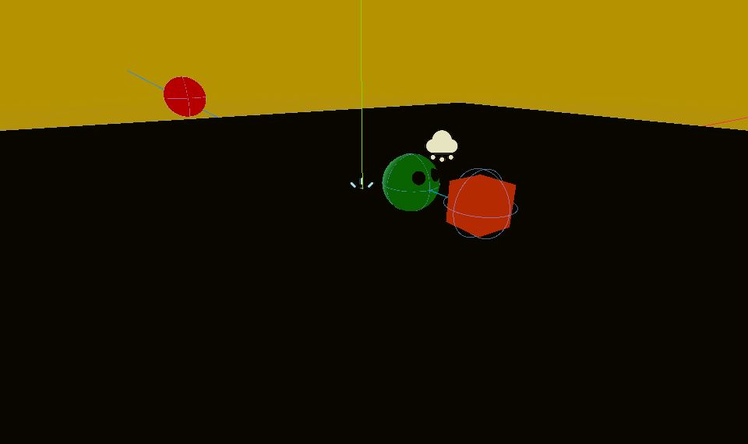
Thankfully It All ended up working out.

